Slide 1
Green IoT at Home
Saving Energy, Water and Money on a daily basis

Slide 2
IoT can help make the world a greener place
Smart appliances allow you to use only the exact amount of water and energy needed.
Promotes awareness of resource consumption and encourages you to be more water and energy efficient.
Connect to your city’s Smart Grid and cause less strain on its resources during peak hours.

Slide 3
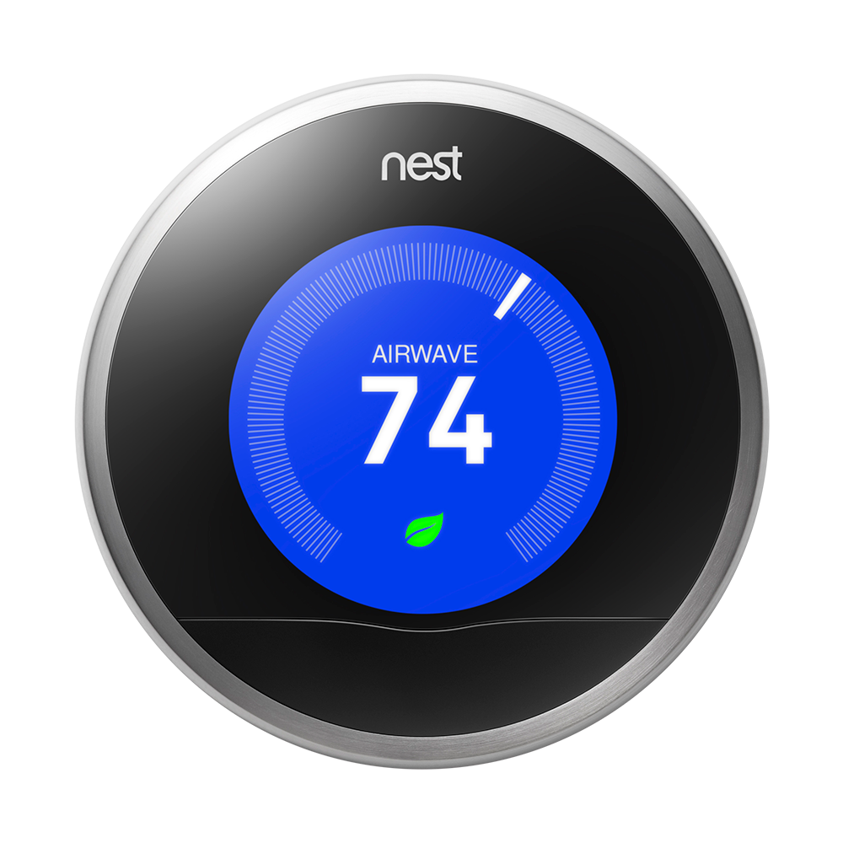
Smart A/C Systems
Only heat/cool the rooms or areas that you actually spend time in.
Control thermostat from your laptop or phone, or let it learn your schedule automatically.
Saves 10-12% in heating, 15% in cooling.
Saves $130-$145 per year in heat and cooling costs. It pays for itself after just 2 years.

Slide 4
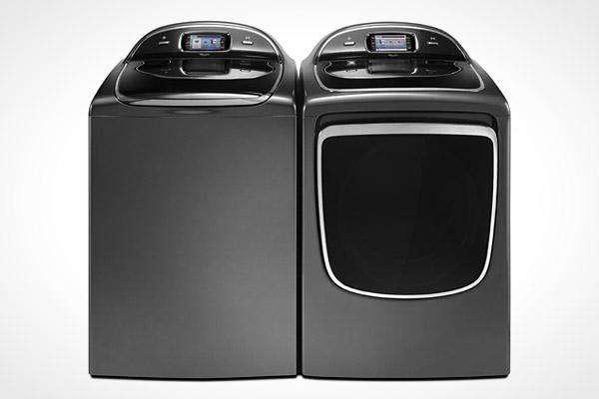
Smart Washer and Dryer
Detects the amount of clothes loaded and can adjust the water and energy used.
Includes app to track savings over time. Typically uses 75% less water and power.

Slide 5
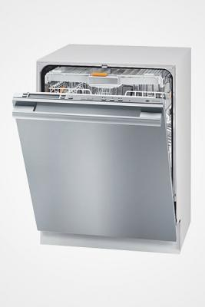
Smart Dishwasher
Detects how many dishes are inside and uses the needed amount of water and detergent.
Soil Sensor determines how dirty dishes are and adjusts accordingly.
Connects to the Smart Grid and can run only during off-peak hours.

Slide 6
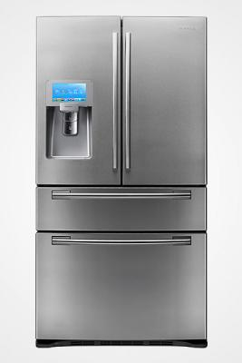
Smart Refrigerator
Different temperature/humidity zones for different types of food.
Power-saving mode to conserve energy when nobody is home through the app.

Slide 7


Smart Grid
In some countries like the US, utility companies charge less for electricity used in the middle of the night, when there is less strain on the system.
Appliances like a refrigerator could delay its energy-intensive tasks (like its defrost cycle) until those times.

Slide 8

Generating Power
Solar panels and Tesla’s Powerwall allow for generating and storing energy for your home.
As this technology improves, homes can become 100% energy independent.

Slide 9
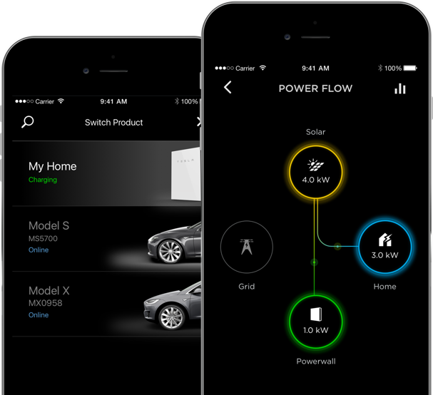
Generating Power (Cont.)
Track how much energy has been generated, used and is currently stored.
Pays for itself in 6 years.
Can even sell energy back to utilities.

